Slide 1




Text Mining HR Appraisal Process Data Using Python

Slide 2
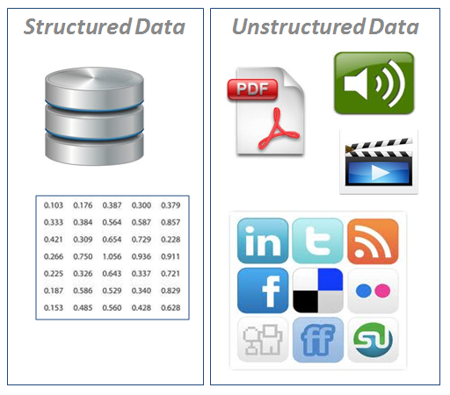
Structured Vs. Unstructured Data

Slide 3
What Is Text Analysis ?
Text Mining is also known as Text Data Mining (TDM) and Knowledge Discovery in Textual Database (KDT)
It is a process of identifying novel information from a collection of texts (Also known as a ‘Corpus’)
Corpus is a collection of ‘documents’ containing natural language text. Here, documents, generally, are sentences. Each document is represented as a separate line.

Slide 4
Case Study – HR Appraisal Process Feedback
Background
Objective
Available Information
The company XYZ carried out Annual Performance Appraisal process which is a routine HR process.
To understand the employee sentiments and incorporate recommendations in the current performance appraisal process.
Feedback and comments from the employees were stored in a text document.
The employees were asked to give feedback about the overall process and questions used for assessing their performance level.

Slide 5
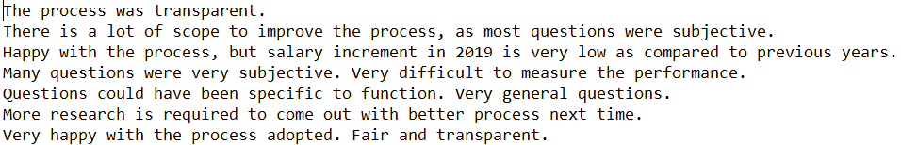
Data Snapshot
HR Appraisal process
Text Observations
*
These are the comments received from employees.
Note that, data is not in structured format.

Slide 6
Text Mining In Python
#Install NLTK library in Anaconda Prompt
pip install nltk
#Import NLTK library
#Import data and convert into ‘Corpus’
import nltk nltk.download() from nltk.book import * text = [line.rstrip() for line in open("HR Appraisal process.txt")] text[0:5]
Install and load NLTK(Natural Language Toolkit) library.
open("HR Appraisal process.txt"): Opens the file "HR Appraisal process.txt" for reading.
line.rstrip(): For each line in the file, the rstrip() method is called to remove any trailing whitespace characters, including the newline character \n at the end of each line.
[line.rstrip() for line in open("HR Appraisal process.txt")]: This is a list comprehension that iterates over each line in the file, applies rstrip() to each line, and stores the result in a list.
The resulting list, text, will contain all the lines from the file "HR Appraisal process.txt", with trailing whitespace removed from each line.
*
Note : When imported nltk, nltk.download() will download the required libraries from NLTK for text mining. Run nltk.download() only for the first time

Slide 7
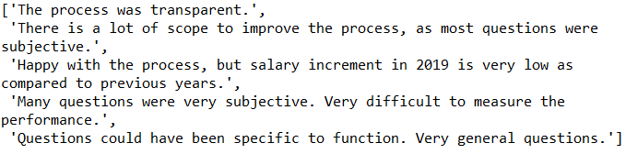
Text Mining In Python
# Output:
Interpretation:
text[0:5] prints first 5 text lines from the data with each line as one set of strings.
# Display a particular document from corpus.
text[2]
'Happy with the process, but salary increment in 2019 is very low as compared to previous years.'
text[2] prints text line of specified number in []. Here it is printing 3rd line.
Python indexing starts from 0, thus 2 represents 3rd data point (sentence).

Slide 8
Text Mining In Python
# Clean the Corpus for further analysis
corp = [item.lower() for item in text] corp [2]
'happy with the process, but salary increment in 2019 is very low as compared to previous years.'
from string import punctuation remove_punc = str.maketrans('','', punctuation) corp = [item.translate(remove_punc) for item in corp] corp[2]
'happy with the process but salary increment in 2019 is very low as compared to previous years'
from string import digits remove_digits = str.maketrans('', '', digits) corp = [item.translate(remove_digits) for item in corp] corp[2]
'happy with the process but salary increment in is very low as compared to previous years'
lower() converts text to lowercase.
maketrans(x,y,z)
Where:
x is a string specifying the characters to be replaced.
y is a string specifying the characters with which to replace x.
z is a string specifying the characters to be removed.
maketrans(‘’,’’,punctuation) removes punctuation
maketrans(‘’,’’,digits) removes digits

Slide 9
Text Mining In Python
# Clean the Corpus for further analysis
from nltk.corpus import stopwords from nltk.tokenize import word_tokenize stop_words = nltk.corpus.stopwords.words('english') fs=[] for item in corp: word_tokens = word_tokenize(item) filtered_sentence = [word for word in word_tokens if word not in stop_words] fs.append(filtered_sentence) fs[2]
['happy', 'process', 'salary', 'increment', 'low', 'compared’, 'previous', 'years']
stopwords("english") remove stop words like: i, me, our, and, the, is, etc.
There are more than 100 in-built English Stopwords in Python NLTK. Use stopwords("english") to view the list of these stopwords.

Slide 10
Text Mining In Python
# Clean the Corpus for further analysis
newStopWords = ['process'] stop_words.extend(newStopWords) fs=[] for item in corp: word_tokens = word_tokenize(item) filtered_sentence = [word for word in word_tokens if word not in stop_words] fs.append(filtered_sentence) fs[2]
['happy', 'salary', 'increment', 'low', 'compared', 'previous', 'years']
If you wish to remove specific words from the corpus use .extend("word") to add the word in list of stopwords. Here “process” word is removed.

Slide 11
Text Mining In Python
import itertools filtered_text = list(itertools.chain.from_iterable(fs)) fdist = nltk.FreqDist(filtered_text)
itertools.chain.from_iterable() function is used to flatten a list of lists (fs) into a single list.
FreqDist() gives frequency of each word in the list
# Find most common words i.e. words having highest frequency
fdist.most_common(10)
[('questions', 13), ('hr', 12), ('happy', 10), ('subjective', 8), ('fair', 7), ('performance', 6), ('work', 6), ('difficult', 5), ('measure', 5), ('salary', 4)]
Interpretation:
“questions”, “hr”, “happy”, “subjective”, “fair”, “performance”, “work”, “difficult”, “measure”, ”salary” are the top 10 words by frequency.
The frequencies of the words are listed besides them.
fdist.most_common(n) gives the list of top n words sorted highest to lowest by frequency

Slide 12
Word Cloud In Python
Word cloud, as the name suggests, is an image showing compilation of words, in which, size of words indicates its frequency or importance.
# Install the library “wordcloud” in Anaconda Prompt
pip install wordcloud
# Get Word Cloud
from wordcloud import WordCloud import matplotlib.pyplot as plt wordcloud = WordCloud(background_color="white").generate(str(filtered_text)) plt.figure(figsize = (8, 8)) plt.imshow(wordcloud); plt.axis("off") plt.tight_layout(pad = 0); plt.show()
background.color allows you to select the color of the background.
fig.size allows you to adjust the size/dimensions of the wordcloud.
plt.imshow() is used to display data as an image.
plt.axis("off") means axis lines and labels are turned off.
plt.tight_layout() automatically adjusts subplot parameters to give specified padding ( here 0).

Slide 13
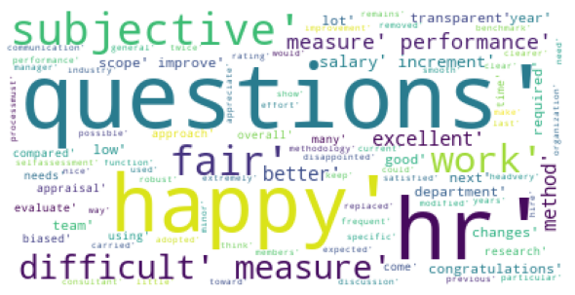
Word Cloud In Python
# Output :
Interpretation:
Word ‘questions’ has largest size, indicating most frequent word followed by ‘happy’ and ‘hr’ and so on..

Slide 14
Text Mining Using Matplotlib
# Plotting frequent terms as a bar plot
a = fdist.most_common(10)
# Transform as a dataframe
import pandas as pd b = pd.DataFrame(a) b = b.rename(columns={0:'Words',1:'Freq'})
# Horizontal bar plot
import numpy as np c=b.Words y=np.arange(len(c)) x=b.Freq plt.barh(y, x, align='center', alpha=0.5) plt.yticks(y, c);plt.ylabel('Words') plt.xlabel('Frequency');plt.title('Words by Frequency') plt.show()

Slide 15
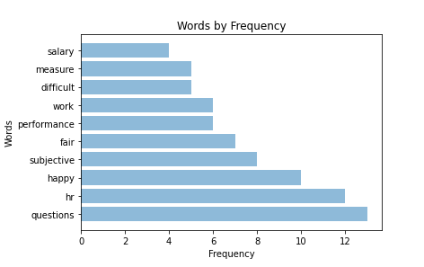
Text Mining Using Matplotlib
# Output :
Interpretation:
Graph shows the frequency of the top 10 words by frequency on a horizontal bar graph. “questions” is the most frequent word with frequency 13.

Slide 16
Quick Recap
In this session, we learnt Text Mining in Python :
Unstructured Data
Does not reside in traditional databases and data warehouses.
Example: emails, tweets, feedback, blogs, webpages, etc.
Text Analysis
Process of identifying novel information from a collection of texts. (Also known as a ‘Corpus’)
Text mining in Python
Install ‘nltk’ library. Convert data into corpus.
Clean the corpus: convert all words to lowercase/uppercase, remove punctuation, numbers, stopwords, words.
Word Cloud in Python
An image showing compilation of words, in which, size of words indicates its frequency or importance.
Install ‘wordcloud’ library.

Slide 17
THANK YOU!
Notes:
Thank you!

